Slide 1
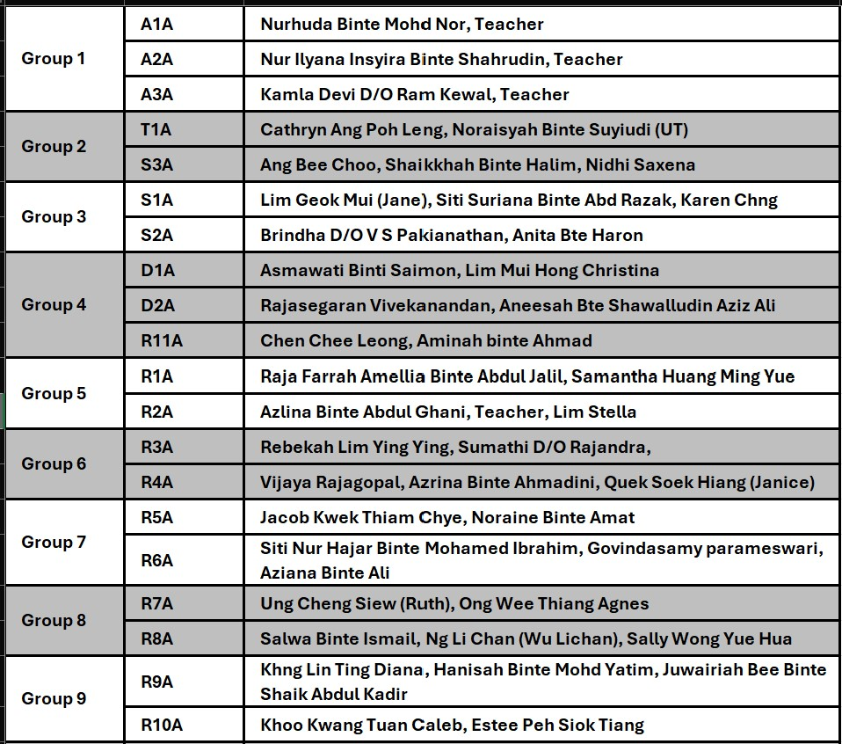
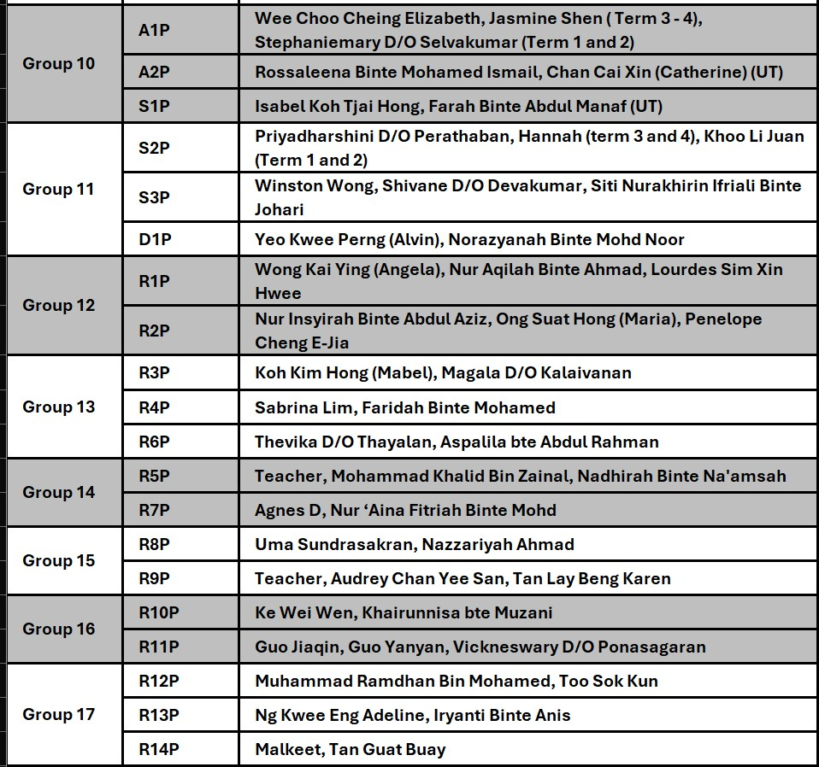
Groupings - FMS PE Workshop
Notes:
[0855-0900]

Slide 2
Fundamental Movement Skills
FGS PE Workshop
Perform FMS
Teach FMS
Access FMS
Notes:
[0900-0905] Hi everyone! Thanks for being here today. It’s great to see all of you again after our first workshop in May. I hope that session gave you a better understanding of how we can approach PE with confidence and creativity. Today’s workshop is about taking things a step further. We’re focusing on three things: how to perform fundamental movement skills properly, how to teach them to our students, and how to assess them meaningfully.
These skills are the building blocks of everything we do in PE, and getting them right is so important—especially for our students here at Fernvale Gardens School. I know that teaching PE can feel a little out of your comfort zone, especially if you don’t have a background in it. But that’s exactly why we’re here. Our goal is to build your confidence and give you practical ideas that you can use right away in your classes. And don’t worry—it’s not about being perfect. It’s about trying, learning, and growing together as a team.
We’ve grouped you into teams based on your classes, and you will be moving around in your groups later. In different areas in the hall, you will be learning a specific skill in various ways. Later, you’ll bring what you’ve learned back to your group and share it with your peers. Let’s make this fun, collaborative, and meaningful for everyone!

Slide 3
Table of contents
01
04
02
05
03
07
Introduction
Teaching and Learning
Importance
Skill Review
Skill Selection
Reflection

Slide 4
Struggles to understand
Non-verbal
Non-responsive
Notes:
[0906-0908]
Now, let’s think about the students we have in FGS.
How many different combinations can there over here? There is actually 7 over here.

Slide 5
Importance
Non-verbal
Verbal
Non-responsive
Responsive
High Energy
Low Energy
Easily Stimulated
Easily Triggered
Struggles to Understand
Difficulty with Transitions
Repetitive Behaviors (e.g., hand flapping, rocking, repeating phrases)
Sensory Sensitivities (e.g., overreaction or underreaction to noise, light, textures)
Difficulty with Social Interactions (e.g., avoiding eye contact, limited interest in group activities)
Delayed Motor Skills (e.g., challenges with fine or gross motor coordination)
Short Attention Span
Resistance to Physical Activities (e.g., reluctance to participate in unfamiliar exercises)
Self-Stimulatory Behaviors (e.g., humming, tapping, spinning)
Echolalia (repeating words or phrases without understanding)
Emotional Outbursts (e.g., crying, yelling, or showing distress)
Notes:
[0909 - 0915] What if there are so many different factors? 524 288 if you include a combi with students not having any of the above factors..
"Let me share a story with you. Imagine our school as a garden, with each student being a unique flower. Some flowers bloom brightly and easily, reaching for the sun. Others take time, needing more care, shade, or water to thrive. This is exactly like our students—they are all different, with their own needs, strengths, and challenges.
Take Adam, for example. Adam is non-verbal and often doesn’t respond when we try to engage him. He prefers to stand on the side, observing quietly. Then there’s Sarah, who is verbal and loves to chat but gets easily overstimulated by noisy environments or too many people moving around her. And finally, there’s David, who is full of energy, always running ahead, but struggles to stay focused or follow instructions. Each of these students has a unique combination of factors that make them who they are.
Now, let’s think about PE. For Adam, learning to roll a ball back and forth with a partner isn’t just about the movement—it’s a chance to connect and interact in his own way. For Sarah, walking along a balance beam in a calm, quiet setting helps her focus and feel accomplished. And for David, hopping or skipping through an obstacle course is a great way to channel his energy while practicing control and coordination.
Here’s why fundamental movement skills matter so much. They aren’t just about physical activity—they’re about independence and growth. When our students learn to hop, throw, or balance, they’re not just building their physical abilities. They’re gaining confidence, discovering new ways to engage with the world, and finding joy in their accomplishments.
What’s important to remember is that teaching these skills isn’t about fitting all students into the same box. It’s about understanding their unique combinations of factors—their energy levels, their communication styles, their sensitivities—and adapting our approach to meet them where they are. This is why the ecological theory is so helpful. It reminds us that development happens when the person, the task, and the environment come together in the right way. For example, Adam might need a quieter space and more guidance, while David thrives in dynamic, fast-paced activities.
As we teach fundamental movement skills, we’re planting seeds of growth. Some seeds will sprout quickly; others will take more time. But every small step—every roll of the ball, every hop, every smile—shows us that these seeds are growing. And that’s the beauty of what we’re doing here."

Slide 6
Skill Selection
Locomotor Skills | Non-locomotor Skills | Manipulative Skills
walking; running; leaping; jumping; hopping; skipping; galloping; sliding; and rolling (roll-like action)/ rotating (as in gymnastics) | curling; stretching; twisting; turning; spinning; pushing; pulling; rocking; swinging; pivoting; and balancing. | rolling; throwing; catching; bouncing, dribbling, trapping; kicking; volleying; and striking
Notes:
[0916-0920] These skills are the foundation that allows students to progress toward more complex and specific movements, such as playing a sport, engaging in leisure activities, or even performing daily tasks. Without these building blocks, students may face challenges when trying to participate in physical activities later in life.
Sports:
Running and Sliding: Used in soccer and basketball for positioning and chasing the ball.
Throwing and Catching: Fundamental in baseball, rugby, and netball.
Balancing and Pivoting: Critical in dance and gymnastics and also martial arts for stability and control.
Leisure Activities:
Skipping and Hopping: Playing jump rope or casual playground games.
Throwing and Catching: Tossing a frisbee or playing catch with family or friends.
Balancing: Walking on uneven surfaces during outdoor activities.
Daily Tasks:
Walking: Moving around school, work, or home.
Pushing and Pulling: Opening doors or pushing a shopping cart.
Twisting and Turning: Grabbing items from behind or from cupboards.
We’re equipping our students with skills that support their work, hobbies, and overall quality of life. These skills build confidence, foster social interaction, and allow our students to explore and enjoy their interests.

Slide 7
Skill Selection (Around the World)
Locomotor Skills | Non-locomotor Skills | Manipulative Skills
a)Leaping - Gp 1 and 2 b)Skipping - Gp 3 and 4 c)Sliding - Gp 5 and 6 | d)Pivoting - Gp 7 and 8 e)Balancing - Gp 9 and 10 | Throwing f)Chest Pass - Gp 11 and 12. g)Underhand Throw - Gp 13 and 14) Dribbling h)Dribbling with One Hand - Gp 15 and 16) i)Striking (Two-handed Sidearm Striking - Gp 17)
We will rotate after every 5 minutes.
Notes:
[0921-1020]
Show videos first
throwing (underhand throw, two hand underhand throw, overhand throw, two hand overhead throw, chest pass, bounce pass)
catching (catch above the waist, catch below the waist, catch ball on the ground)
dribbling (dribbling with hands, dribbling with legs); trapping (using inside of the foot, using sole of the foot)
kicking (inside of the foot kick, instep kick)
volleying (forearm pass, overhead volley)
striking (underhand strike and overhead strike and sidearm strike with rackets/paddles) + two handed sidearm striking

Slide 8
Layout
i)Two-Handed Side Arm Striking
PE Equipment
a)Leaping
h)Dribbling With One Hand
Field
g)Underhand Throw
b)Skipping
d)Pivoting
c)Sliding
Toilets
f)Chest Pass
Hall Stage
e)Balancing
Notes:
[0921-1010]

Slide 9
Reflection

Slide 10
Thank you for your attention
Do you have any questions?
Please keep this slide for attribution

Slide 11
Equipment Prep
i)Two-Handed Side Arm Striking
3 Tee Stands
6 assorted bats
6 assorted balls
PE Equipment
10 basketballs
10 cones
2 lines
6 cones
3 lines
3 mini hurdles
a)Leaping
h)Dribbling With One Hand
10 assorted balls
2 cone targets
2 hoop targets
2 basket targets
Play with partners
6 cones
3 lines
https://www.youtube.com/watch?v=SbIcsqsyzYs
Field
g)Underhand Throw
b)Skipping
d)Pivoting
3 lines
6 cones
3 beanbags
3 lines
6 cones
3 balls
3 spot markers
10 basketballs
10 spot markers
wall
c)Sliding
Toilets
f)Chest Pass
10 spot markers
10 yoga mats
10 hand markers
10 foot markers
Hall Stage
e)Balancing
Notes:
[0921-1010]

