Slide 1
Review of FGS CCA Policy and Guidelines
PE, OE and CCA Dept; 2 Jan 2025

Slide 2
Presentation Overview
01
02
Roles and Responsibilities of Stakeholders
CCA Timeline Overview
Notes:
[2 min]
Review key guidelines and policies for CCAs at FGS.
CCAs play an integral role in our students’ holistic education, and your contributions are essential to their success.
Here’s an overview of what we’ll cover today: We’ll begin with the roles and responsibilities of various stakeholders, move on to the CCA timeline and commencement details, and finally conclude with a Q&A session."

Slide 3
Role of HOD of PE, OE and CCA
- Supervisor of CCAs
- Refines events/processes (if necessary)
- Manages teacher deployment
- Manages budgets
Notes:
The HOD oversees all CCAs, refines events and processes, deploys teachers effectively, and ensures budgets are approved and aligned with school goals."

Slide 4
Role of CCA Coordinators
- Assist in overseeing planning and conduct of CCAs
- Reviews work plans/budgets
Notes:
"The CCA Coordinators play a crucial role in supporting the HOD by managing attendance records, reviewing work plans, and ensuring budgets are accurately tracked and used efficiently."

Slide 5
Role of CCA Heads and Assistant Heads
- Plans CCA workplan (for meaningful and engaging CCA programmes) and budget
- Collaborates with vendors/instructors
- Ensures CCA sessions are conducted in accordance with the workplan
Notes:
CCA Heads and Assistant Heads are responsible for planning programmes tailored to students’ diverse needs, ensuring differentiation, and working closely with instructors to deliver meaningful and impactful CCA sessions.

Slide 6
Role of CCA Teachers-In-charge
- Records attendance
- Manages behavior and safety of students
- Ensures students’ learning through differentiated instructions
Notes:
Teachers-in-charge are on the frontline, ensuring safety, maintaining discipline, and creating an engaging environment where students can thrive. They also play a key role in fostering values through their daily interactions with students.

Slide 7
CCA Timeline Overview
No. | Activity | Period | Action By
1 | Review Work Plan of current year and submit to HOD PE, OE & CCA | T4W9 | CCA Team of current year
2 | Confirmation of CCA deployment for following year | T4W10 | HOD PE, OE & CCA
3 | Inform all staff of deployment for following year | T4W10 | HOD PE, OE & CCA
4 | Meet up to do a draft Work Plan and budget for following year and submit to HOD PE, OE & CCA | T4W10 | CCA Team of following year
5 | Prepare ITQ for vendors/equipment/learning journeys/others if necessary | Nov Holiday Work Week | CCA Team of following year
6 | CCA Orientation Day (Presentation slides for every year) (CCA fair to be held every two years) | T1W3 | CCA Coordinators
Notes:
"Here’s the CCA timeline for the year. Key dates include the commencement of CCAs in Term 1, Week 6, and submission deadlines for work plans, budgets, and approvals. Let’s ensure all deadlines are adhered to for smooth operations.

Slide 8
CCA Timeline Overview
No. | Activity | Period | Action By
7 | Selection/Change of CCA (Enrolment of new members every year) (Students are allowed to change CCA every two years) | T1W3 | CCA Coordinators
8 | Discussion of allocation of CCA members | T1W4 | HOD PE, OE & CCA CCA Coordinators and CCA Teams
9 | Confirmation of CCA members | T1W5 | HOD PE, OE & CCA
10 | Post CCA Information letter to parents/caregivers | T1W5 | CCA Coordinators
11 | Individual meetings for all CCAs (Confirmation of Work Plan, Budget) | T1W5 | CCA Teams
12 | Start of CCA sessions (1.5 hr) on Weds (25 sessions; Weds) AM: 10.00 a.m. to 11.30 a.m. PM: 1.00 p.m. to 2.30 p.m. | T1W6 (Will start on T1W7 if T1W6 is a holiday) | CCA Teams
Notes:
CCAs will commence in Term 1, Week 6, with a total of 25 sessions per year, each lasting 1.5 hours. Adjustments will be made for public holidays to ensure the full programme is delivered.

Slide 9
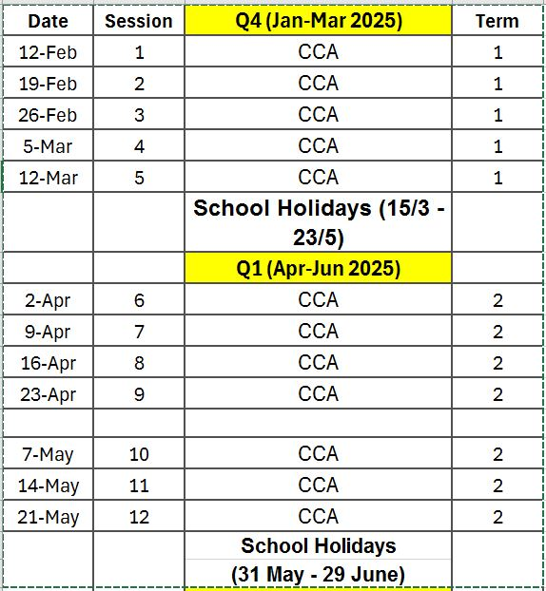
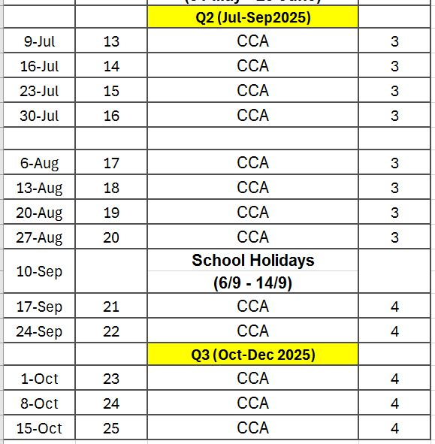

Slide 10
Thank You
Please keep this slide for attribution
Notes:
Thank you for your attention. Let’s work together to ensure our CCAs are impactful and enriching for our students. I’d now like to open the floor for questions or clarifications.

